Slide 1
Computer Graphics: Line Drawing Algorithms
Scan Conversion Algorithms
(Midpoint Line)

Slide 2
Find out the first 7 pixels of the line segment starting from (0, 2) to (70, 52) using midpoint line algorithm

Slide 3
7
6
5
4
3
2
0
1
2
3
4
5
6
7

Slide 4
x | y | d | NE(+1,+1)/E(+1,0) | d updating | Pixel
0 | 2

Slide 5
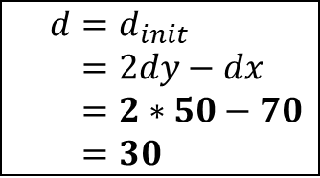
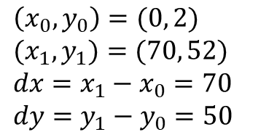

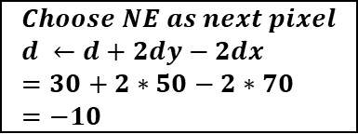
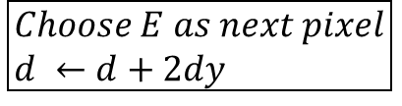

yes
no
no
yes
end

Slide 6
x | y | d | NE(+1,+1)/N(0,+1) | d updating | Pixel
0 | 2 | 30 | NE | 30+2x50-2x70 = -10 | (0, 2)
1 | 3

Slide 7
7
6
5
4
3
2
0
1
2
3
4
5
6
7

Slide 8
x | y | d | NE(+1,+1)/E(+1,0) | d updating | Pixel
0 | 2 | 30 | NE | 30+2x50-2x70 = -10 | (0, 2)
1 | 3

Slide 9
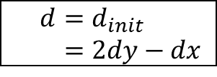
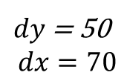

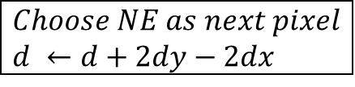
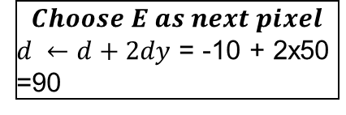
yes
no
no
yes
end

Slide 10
x | y | d | NE(+1,+1)/E(+1,0) | d updating | Pixel
0 | 2 | 30 | NE | 30+2x50-2x70 = -10 | (0, 2)
1 | 3 | -10 | E | -10+2x50 = 90 | (1, 3)
2 | 3

Slide 11
7
6
5
4
3
2
0
1
2
3
4
5
6
7

Slide 12
x | y | d | NE(+1,+1)/E(+1,0) | d updating | Pixel
0 | 2 | 30 | NE | 30+2x50-2x70 = -10 | (0, 2)
1 | 3 | -10 | E | -10+2x50 = 90 | (1, 3)
2 | 3

Slide 13
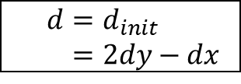

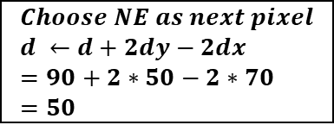
yes
no
no
yes
end

Slide 14
x | y | d | NE(+1,+1)/E(+1,0) | d updating | Pixel
0 | 2 | 30 | NE | 30+2x50-2x70 = -10 | (0, 2)
1 | 3 | -10 | E | -10+2x50 = 90 | (1, 3)
2 | 3 | 90 | NE | 90+2x50-2x70 = 50 | (2, 3)
3 | 4

Slide 15
7
6
5
4
3
2
0
1
2
3
4
5
6
7

Slide 16
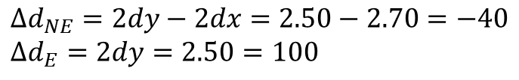
x | y | d | NE(+1,+1)/E(+1,0) | d updating | Pixel
0 | 2 | 30 | NE | 30+2x50-2x70 = -10 | (0, 2)
1 | 3 | -10 | E | -10+2x50 = 90 | (1, 3)
2 | 3 | 90 | NE | 90+2x50-2x70 = 50 | (2, 3)
3 | 4

Slide 17
x | y | d | NE(+1,+1)/E(+1,0) | d updating | Pixel
0 | 2 | 30 | NE |  | (0, 2)
1 | 3 | -10 | E |  | (1, 3)
2 | 3 | 90 | NE |  | (2, 3)
3 | 4

Slide 18
x | y | d | NE(+1,+1)/E(+1,0) | d updating | Pixel
0 | 2 | 30 | NE |  | (0, 2)
1 | 3 | -10 | E |  | (1, 3)
2 | 3 | 90 | NE |  | (2, 3)
3 | 4 | 50 | NE |  | (3, 4)
4 | 5

Slide 19
7
6
5
4
3
2
0
1
2
3
4
5
6
7

Slide 20
x | y | d | NE(+1,+1)/E(+1,0) | d updating | Pixel
0 | 2 | 30 | NE |  | (0, 2)
1 | 3 | -10 | E |  | (1, 3)
2 | 3 | 90 | NE |  | (2, 3)
3 | 4 | 50 | NE |  | (3, 4)
4 | 5 | 10 | NE |  | (4, 5)
5 | 6

Slide 21
7
6
5
4
3
2
0
1
2
3
4
5
6
7

Slide 22
x | y | d | NE(+1,+1)/E(+1,0) | d updating | Pixel
0 | 2 | 30 | NE |  | (0, 2)
1 | 3 | -10 | E |  | (1, 3)
2 | 3 | 90 | NE |  | (2, 3)
3 | 4 | 50 | NE |  | (3, 4)
4 | 5 | 10 | NE |  | (4, 5)
5 | 6 | -30 | E |  | (5, 6)
6 | 6

Slide 23
7
6
5
4
3
2
0
1
2
3
4
5
6
7

Slide 24
x | y | d | NE(+1,+1)/E(+1,0) | d updating | Pixel
0 | 2 | 30 | NE |  | (0, 2)
1 | 3 | -10 | E |  | (1, 3)
2 | 3 | 90 | NE |  | (2, 3)
3 | 4 | 50 | NE |  | (3, 4)
4 | 5 | 10 | NE |  | (4, 5)
5 | 6 | -30 | E |  | (5, 6)
6 | 6 | 70 | NE |  | (6, 6)
7 | 7

Slide 25
7
6
5
4
3
2
0
1
2
3
4
5
6
7

Slide 26
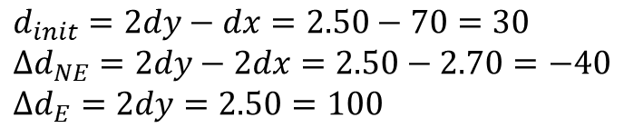
x | y | d | NE(+1,+1)/E(+1,0) | d updating | Pixel
0 | 2 | 30 | NE |  | (0, 2)
1 | 3 | -10 | E |  | (1, 3)
2 | 3 | 90 | NE |  | (2, 3)
3 | 4 | 50 | NE |  | (3, 4)
4 | 5 | 10 | NE |  | (4, 5)
5 | 6 | -30 | E |  | (5, 6)
6 | 6 | 70 | NE |  | (6, 6)
7 | 7

